Slide 1

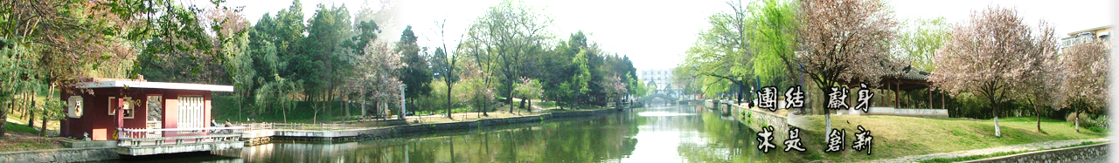
9 Parameter Estimation
EOE Postgraduate Courses
Multi-sensor Data Fusion
wangjingqi@njust.edu.cn

Slide 2
Contents
9.1 Introduction
9.2 Parameter Estimation （参数估计）
9.3 Bayesian Curve Fitting （贝叶斯曲线拟合）
9.4 Maximum Likelihood （最大似然）
9.5 Least Squares （最小平方）
9.6 Linear Gaussian Model （线性高斯模型）
9.7 Generalized Millman Formula（广义Millman公式）

Slide 3


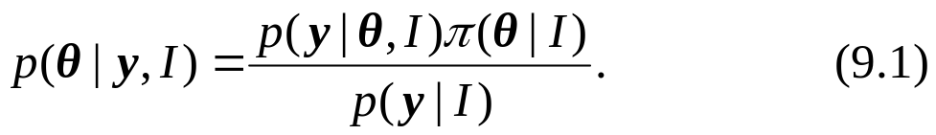
9.1 Introduction
Parameter Estimation （参数估计）
a set of N multi-dimensional sensor observations y_{i}.
where
suppose the y_{i} were generated by a parametric distribution p(y|θ, I), where θ=(θ₁, θ₂, . . . , θ_{K})^{T} are the parameters and I is any background information.
Then parameter estimation involves estimating θ from y.
Bayesian Theorem （贝叶斯定理）
a priori
a posteriori

Slide 4
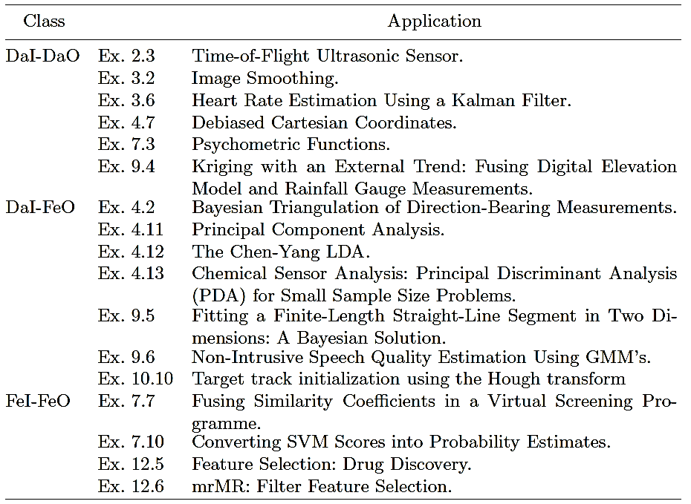
Table 9.1. Applications in which Parameter Estimation is the Primary Fusion Algorithm
Dasarathy input/output classifications: “Data Input-Data Output”, “Data Input-Feature Output” and “Feature Input-Feature Output”

Slide 5
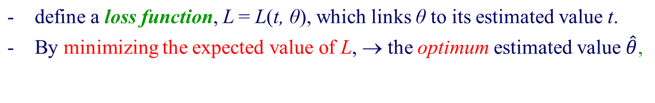
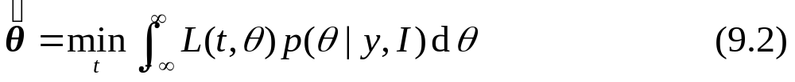


9.2 Parameter Estimation
Estimate Parameters θ using a posteriori distribution （利用后验分布进行参数估计）
Loss Functions （损失函数）
Quadratic Loss Function （平方损失函数）
the expected value of θ
Notes:
Once the a posterior distribution is available we can use it to estimate the parameters θ.
In what follows we shall suppose θ is a scalar parameter, θ.
Quadratic Loss Function. This is defined as L(t, θ) = Δ2, where Δ = t −
θ. In this case, the corresponding MMSE (minimum mean square error)
estimate, ˆθMMSE, is equal to the expected value of θ:

Slide 6


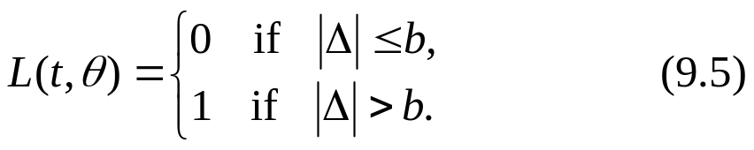
Absolute Loss Function （绝对损失函数）
MMAE (minimum mean absolute error) estimate, ˆθ_{MMAE},
最小平均绝对误差估计
the median of the distribution of θ.
Zero-One Loss Function.（零一损失函数）
Estimate — the center of the interval of width 2b which has the highest probability.
If b goes to zero, then the zero-one estimate converges to the maximum a posteriori (MAP) estimate:
最大后验估计

Slide 7
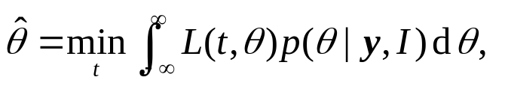
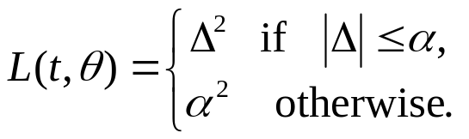

Example: a robust version of the quadratic loss function
（平方损失函数的鲁棒形式）
Example 9.1. Color Constancy and the Minimum Local Mass (MLM) Loss Function.
Let p(θ|y, I)denote the a posteriori distribution for the illuminants and the surface colors in a given scene.
The best estimate of the surface color estimate is
None of the above loss functions were appropriate. Instead a “robust” version of the quadratic loss function is used:
and α is a fixed constant.
□
Notes:
Color constancy is defined as the ability of a visual system to maintain object colour appearance across variations in factors extrinsic to the object.
Human vision exhibits approximate color constancy. Let p(θ|y, I)
denote the a posteriori distribution for the illuminants and the surface colors in a given scene. By definition, the best estimate of the surface color estimate is

Slide 8
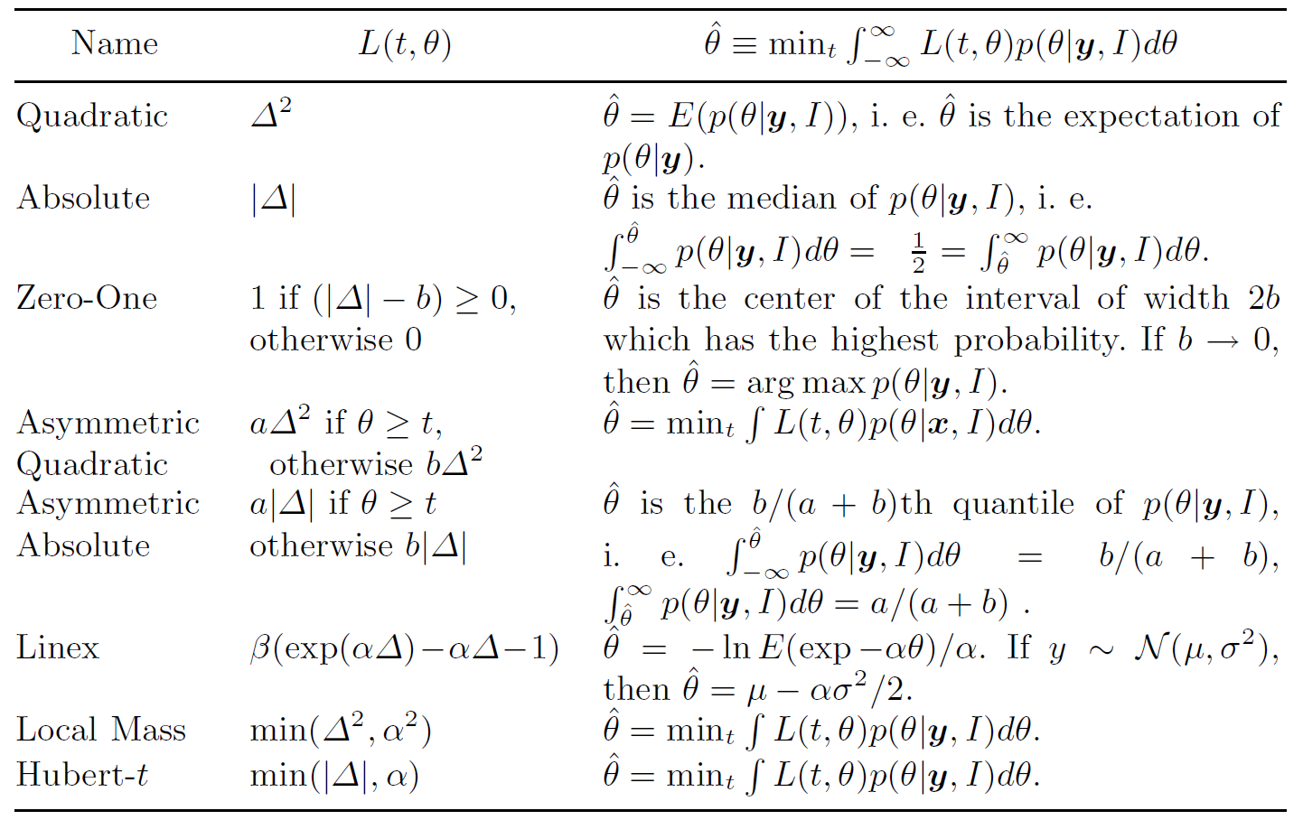
Table 9.2. Loss Functions L(t, θ) and their Bayesian Estimators

Slide 9
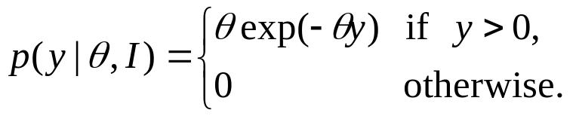
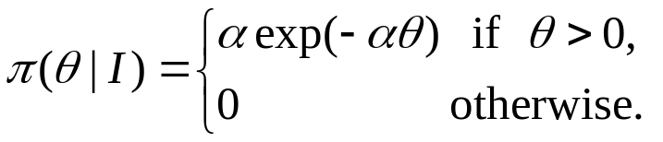
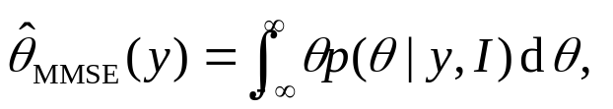
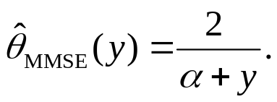
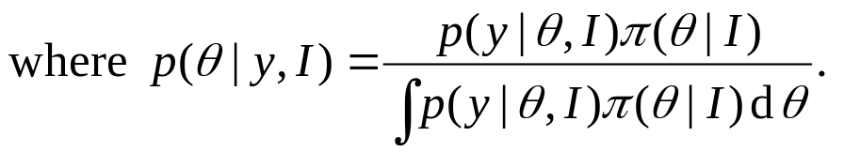
Example: Calculation of the MMSE estimate for the exponential distribution.
Example 9.2. Exponential Distribution. （指数函数的最大后验估计）
the likelihood p(y|θ, I)
Corresponding prior conjugate distribution:
The MMSE estimate is
Notes:
Color constancy is defined as the ability of a visual system to maintain object colour appearance across variations in factors extrinsic to the object.
Human vision exhibits approximate color constancy. Let p(θ|y, I)
denote the a posteriori distribution for the illuminants and the surface colors in a given scene. By definition, the best estimate of the surface color estimate is

Slide 10
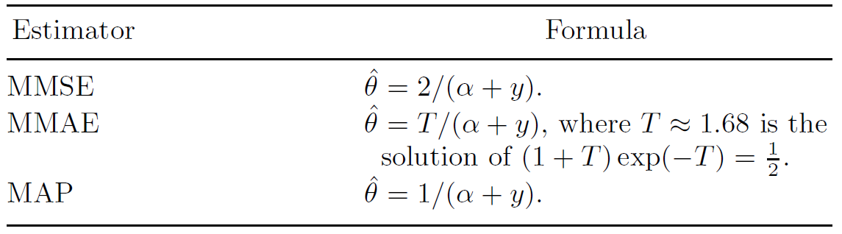
By using the appropriate loss function we may also find the MMAE and MAP solutions.
Table 9.2. Loss Functions L(t, θ) and their Bayesian Estimators
□
Notes:
Color constancy is defined as the ability of a visual system to maintain object colour appearance across variations in factors extrinsic to the object.
Human vision exhibits approximate color constancy. Let p(θ|y, I)
denote the a posteriori distribution for the illuminants and the surface colors in a given scene. By definition, the best estimate of the surface color estimate is

Slide 11
9.3 Bayesian Curve Fitting （贝叶斯曲线拟合）
Regard curve fitting as a problem in parameter estimation
Given a set of pairs of input measurements (y_{i}, u_{i}), i∈{1, 2, . . .,N}, we estimate the parameters of an algebraic curve which best fits these data.
Straight-line regression （直线回归） — fit a straight-line to several sensor measurements y_{i}, i∈{1, 2, . . .,N}.
Example 9.3. Track Initialization Using a Multiple Straight-Line Regression Algorithm.
In surveillance applications, a Kalman filter (a sequential algorithm) is used to track all of the objects which move in a given surveillance area.
To initiate the Kalman filter, an initial set of tracks should be created, one track for each object.
□

Slide 12
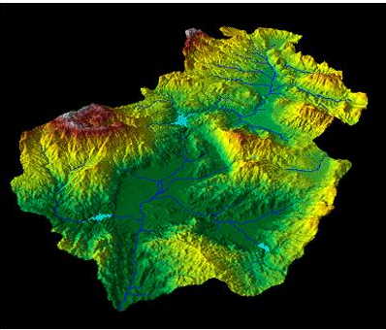
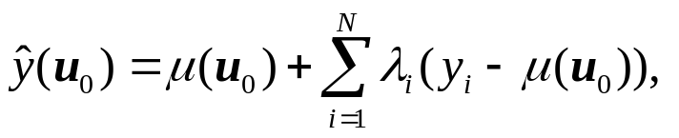
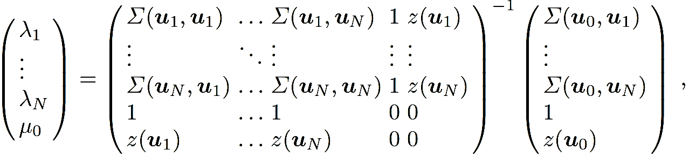
Kriging estimator （克里格估计）
Example 9.4. Kriging with an External Trend: Fusing Digital Elevation Model and Rainfall Gauge Measurements.
Consider the rain gauge measurements y(u_{i}), i ∈ {1, 2, . . .,N}, supplemented by elevation data z, we estimate the rainfall at the point u₀ in Kriging with an external trend (KED ):
in which we model the mean value μ(u₀) as a linear function of z. The unknown mean, μ₀ = μ(u₀) , and the weights, λ_{i}, are given by the Kridging matrix equation.
□
Notes:
High resolution estimates of the spatial variability of rainfall are important for the identification of locally intense storms which can lead to floods and especially to flash floods.
(see Sect. 4.3).
We now consider the situation where the rain gauge measurements are supplemented by elevation data which we assume is correlated with the rainfall and which is available for all u.
In Kriging wixth an external trend (KED) we estimate the rainfall at the
point u0 using a Kriging estimator (4.5):

Slide 13
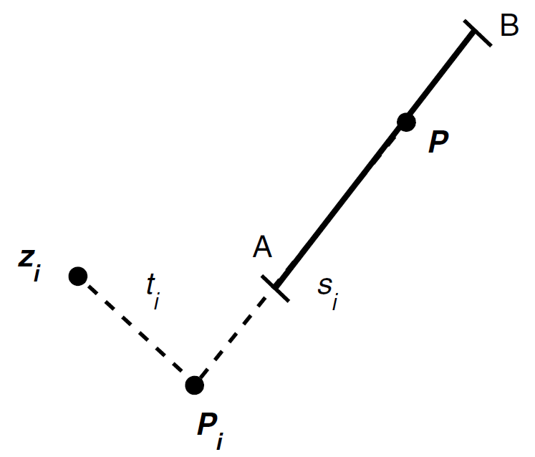
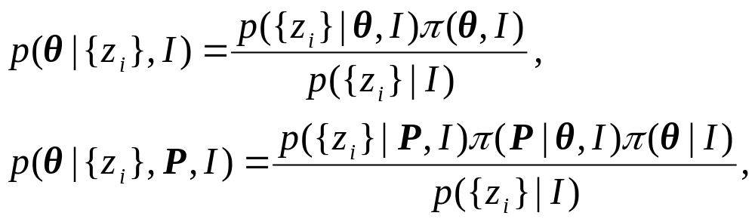
Bayesian curve fitting （贝叶斯曲线拟合）
Example 9.5. Fitting a Straight-Line Segment in Two Dimensions.
Consider the problem of fitting a straight-line, L ≡ L(θ), to a set of points, z_{i}=(x_{i}, y_{i}), i ∈ {1,2,…, N}, where θ={(x_{A}, y_{A}), (x_{B}, y_{B})} denotes the Cartesian coordinates of the end points, A and B.
Let {z_{i}} = {z₁, z₂, …, z_{N}},
p(θ|{z_{i}}, I)
Using Bayes’ theorem and introducing the dummy variable, P, gives
where P=(x,y) is any point on the straight-line L(θ).
Notes:
consider the problem of optimally fitting a straight-line segment to a set of two-dimensional sensor measurements yi, i ∈ {1, 2, . . .,N}.
The algorithm calculates both the slope and intercept of the corresponding straight-line and the end points of the straight-line segment.
Example 9.5. Fitting a Straight-Line Segment in Two Dimensions [327]. We consider the problem of fitting a straight-line, L ≡ L(θ), to a set of points,
zi = (xi, yi), i ∈ {1, 2, . . .,N}, where θ = (xA, yA), (xB, yB) denotes the Cartesian coordinates of the end points, A and B (Fig. 9.1). Let {zi} = {z1, z2, . . . , zN}.
Then our problem reduces to calculating the a posteriori probability density function p(θ|{zi}, I). Using Bayes’ theorem and introducing
the dummy variable, P, gives

Slide 14
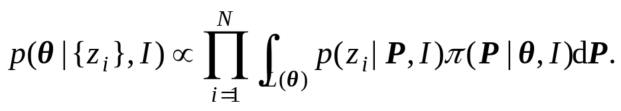
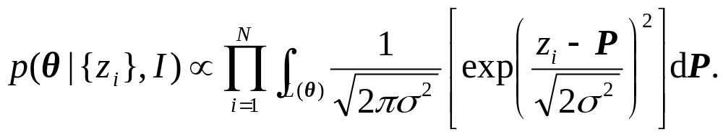


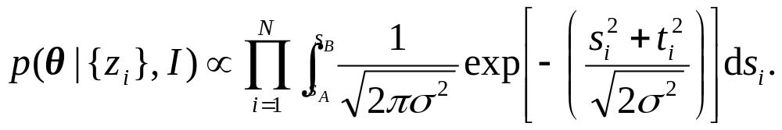
Treat P as a nuisance parameter which we eliminate by integration.
Assuming: independent z_{i}, and a uniform distribution for π(θ|I),
Assuming a zero-mean, variance σ², Gaussian noise model and a uniform distribution for π(P|θ, I),
Let P_{i} denote the point on L(θ) which is nearest to Z_{i},
It may be solved numerically.

Slide 15
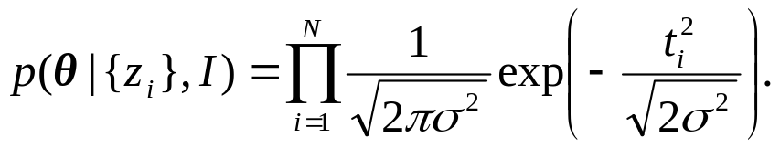
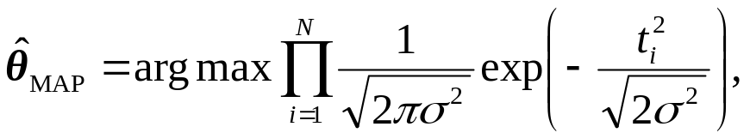
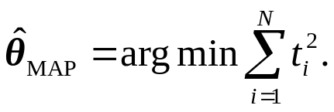
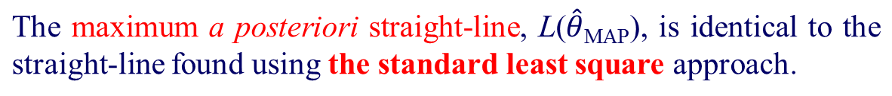
Special Case: the line extend to ±∞.
The corresponding maximum a posteriori (MAP) value for θ is
or equivalently,
□
Notes:
Special Case. An important special case occurs when we let the line extend
to ±∞. In this case the a posteriori probability is

Slide 16
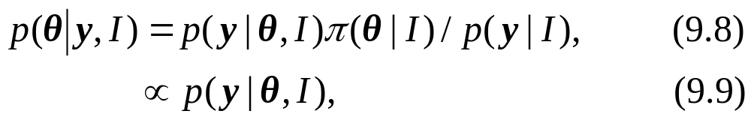

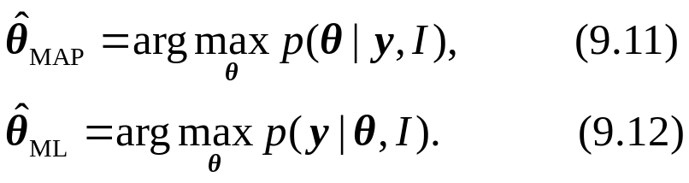
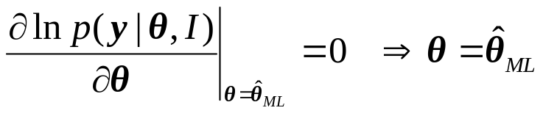
9.4 Maximum Likelihood（最大似然）
In the case of a uniform a priori distribution π(θ|I), the a posteriori density p(θ|y, I) is proportional to the likelihood function p(y|θ, I):
The maximum a posteriori solution is identical to the maximum likelihood solution:
where
Assuming a differentiable function,
Notes:
9.3. Track Initialization Using a Multiple Straight-Line Regression Algorithm [13, 24]. In surveillance applications we often use a Kalman filter (Sect. 11.3) to track all of the objects which move in a given surveillance area.
The Kalman filter is a sequential algorithm in which the tracks are updated as new sensor observations are received. To initiate the Kalman filter we must, however, create an initial set of tracks, one track for each object.
This is often performed using a Hough transform (see Ex. 10.10).

Slide 17
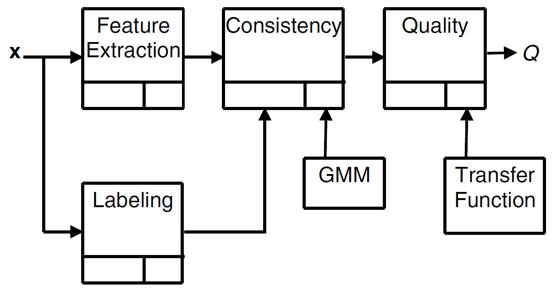
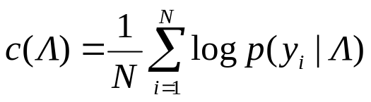
ML-EM algorithm
Expectation-maximization (EM) algorithm, relying on the maximum-likelihood estimator.
Example 9.6. Nonintrusive Speech Quality Estimation Using GMM’s
Fig. 9.2. non-intrusive speech quality estimation algorithm.
Notes:
The maximum likelihood estimator is the most widely used estimation method and is often used in combination with other optimization/estimation procedures.
For example, the expectation-maximization (EM) algorithm, relies on the maximum-likelihood estimator and for this reason the algorithm is often referred to as the ML-EM algorithm.
The following example illustrates the use of the ML-EM algorithm in a speech quality estimation procedure.

Slide 18
The feature extraction module extracts perceptual features from each time frame.
(2) The labeling module labels each time frame of the speech signal as voiced (V ), unvoiced (U) or inactive (I).
— a reference model of the behavior of clean speech features.
— A mixture model GMM(Λ) is used to model the probability distribution of the features for each class Λ ∈ {U, V, I}.
(3) The consistency module which calculates the consistency measure c(Λ);
(4) The quality measure module which calculates the speech quality Q.
The three consistency values c(Λ) are fused together and then converted to a speech quality Q.
Notes:
Offline, high-quality undistorted speech signals are used to produce a reference model of the behaviour of clean speech features.

Slide 19
Note：ML procedure has no mechanism for regulating its solution → the solution may prove to be completely wrong, or wildly optimistic.
Example 9.7. Completion of a Doctoral Thesis: ML vs. MAP .
Student provide a precise time for the completion of his thesis , T .
Supervisor’s estimation:
“maximum likelihood” —— not use any a priori information and will uncritically accept the students estimate.
“Bayesian” ——use all the a priori information which is available. For example, he may use his knowledge of human psychology and conjecture that a student working under pressure will almost certainly underestimate the time required to complete his PhD thesis.
Although the likelihood function is only high for t ∼ T , the a priori probability that T is a reasonable date, given the student is working under pressure, is sufficiently low to make the estimate t ≈ T highly unlikely.

Slide 20
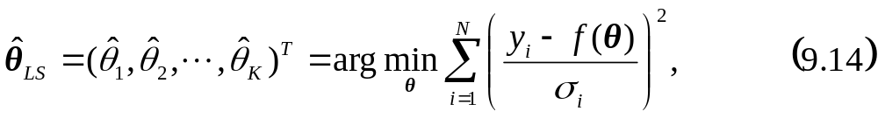
9.5 Least Squares （最小平方）
Least Squares (LS):
An a posterior probability density function p(θ|y, I) cannot be defined.
One-dimensional scalar measurements y = (y₁, y₂, . . . , y_{N})^{T} , which are noisy samples of an “ideal” function y = f(θ).
If y_{i} are independent, then the least square estimate is defined as
minimize the sum of the square differences (y_{i} − f(θ))².
where σ²_{i} is the noise variance in y_{i}.
Notes:
When an a posterior probability density function p(θ|y, I) cannot be defined, we may optimally determine the parameters θ by using a deterministic, i. e. non-probabilistic, method.

Slide 21

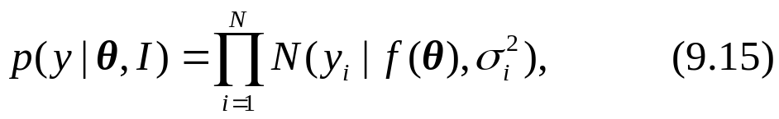

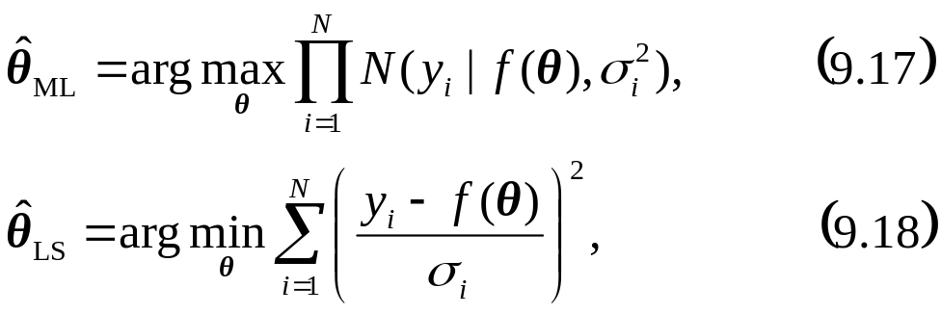

LS, ML and MAP （最小平方，最大似然和最大后验）
Assuming
the likelihood function is
The maximum likelihood solution is numerically identical to the least square solution.
where
Additionally assuming a uniform a priori distribution π(θ|I) for θ, then
Notes:
When an a posterior probability density function p(θ|y, I) cannot be defined, we may optimally determine the parameters θ by using a deterministic, i. e. non-probabilistic, method.
Additionally assuming a uniform a priori distribution π(θ|I) for θ, then the maximum a posteriori solution becomes equal to the maximum likelihood (and least square) solution.

Slide 22

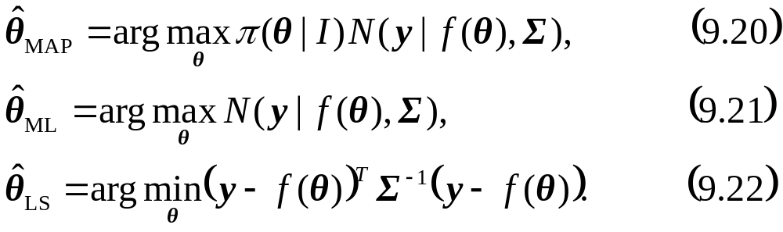
LS, ML and MAP
In general,, if a priori distribution π(θ|I) is uniform and the input measurement vector y follows a multivariate Gaussian distribution y ∼ N(y|f(θ),Σ).
where
The MAP, ML and LS solutions are numerically equal.
Notes:
When an a posterior probability density function p(θ|y, I) cannot be defined, we may optimally determine the parameters θ by using a deterministic, i. e. non-probabilistic, method.
Additionally assuming a uniform a priori distribution π(θ|I) for θ, then the maximum a posteriori solution becomes equal to the maximum likelihood (and least square) solution.

Slide 23
Example 9.8. Fitting Covariance Measurements to a Spatial Covariance Model.
（将一组实验得到的协方差矩阵与空间协方差模型拟合）
The calculation of the Kriging estimators to construct a GIS requires a positive-definite spatial covariance matrix Σ(u_{i},u_{j} ).
fit the experimentally measured Σ(u_{i},u_{j} ) values to a parametric model Σ(u_{i},u_{j} |θ) designed to be positive definite.
determine the parameter vector θ using the method of least squares in which we suppose all yi are equally important.
ordinary least square procedure
□
Notes:
Example 9.8. Fitting Covariance Measurements to a Spatial Covariance Model [52].
In Sect. 4.3.1 we described the construction of a GIS using the Kriging estimators.
The calculation of these estimators require a positive-definite spatial covariance matrix Σ(ui,uj ).
One way of ensuring this is to fit the experimentally measured Σ(ui,uj) values to a parametric model Σ(ui,uj |θ) which has been designed to be positive definite.
Traditionally, we determine the parameter vector θ using the method of least squares in which we suppose all yi are equally important.
In this case the calculation of θ reduces to

Slide 24

9.6 Linear Gaussian Model（线性高斯模型）
Definition
- The Linear Gaussian Model describes a linear model between two vectors y and θ with Gaussian errors.
where
y is a N × 1 vector of scalar measurements (y₁, y₂, . . . , y_{N})^{T} ,
H is a known N × K matrix,
θ is a K × 1 random vector of linear coefficients, (θ₁, θ₂, . . . , θ_{K})^{T} with a priori pdf, N(μ,Σ),
and w = (w₁, w₂, . . ., w_{N})^{T} is a N × 1 noise vector with pdf, N(0, σ²I), and independent of θ.

Slide 25
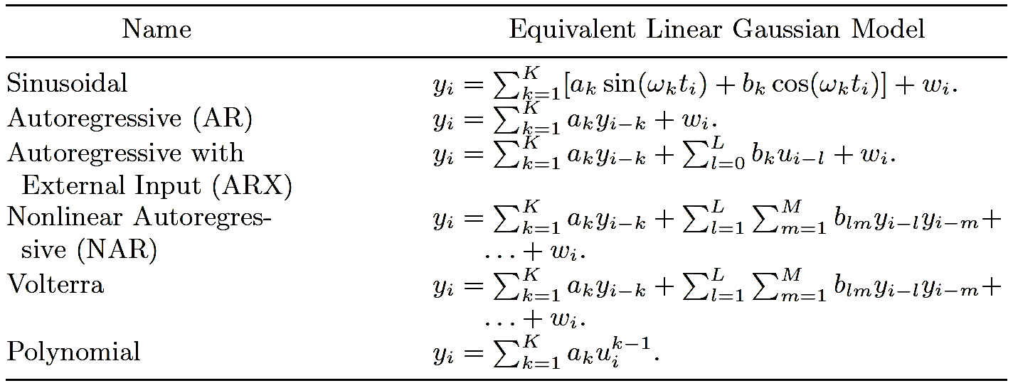
Table 9.4. Representations which use the Linear Gaussian Model
（可以写成线性高斯模型的一些统计模型）
Notes:
The Linear Gaussian Model forms the basis for much statistical modelling.
In the table, we list some common statistical models which may be written in the form of a linear Gaussian model.

Slide 26
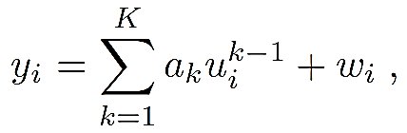
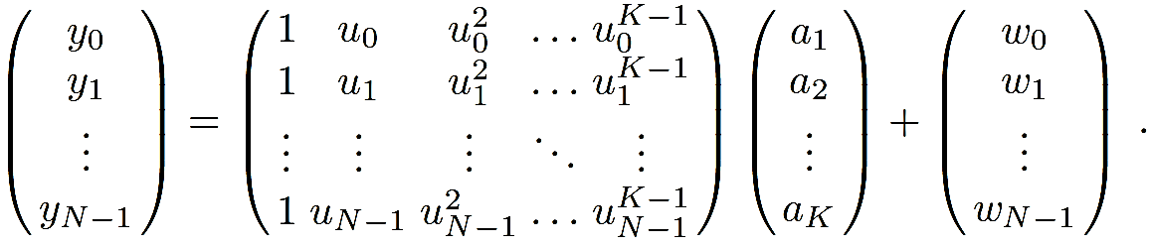
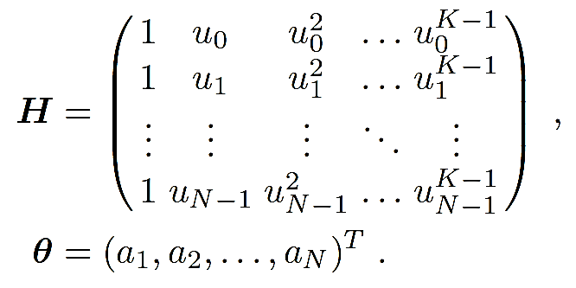
Re-write the polynomial model as a linear Gaussian model.
（将二项式模型写成线性高斯模型）
Example 9.9. Polynomial Model.
The polynomial model
or, in matrix form, as
w_{i} are iid, w_{i} ∼ N(0, σ²)
□

Slide 27
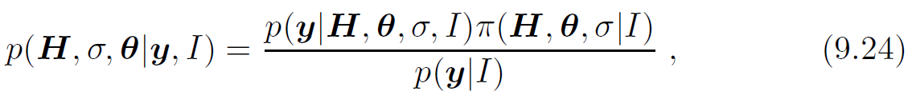
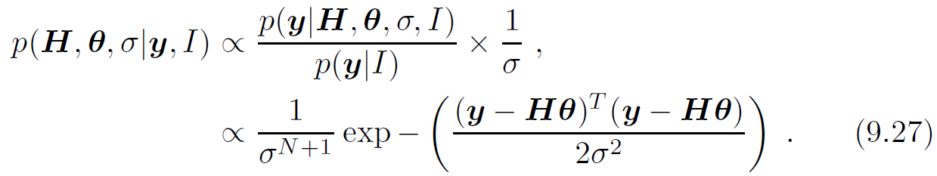
The a posteriori pdf of the linear Gaussian model parameters
（线性高斯模型参数的后验概率分布函数）
By Bayes’ theorem,
where we assume the noise components are iid, w_{i} ∼(0, σ²)
2
Assuming H, θ and σ independent,
Using uniform priors for H and θ and Jeffrey’s prior for σ,

Slide 28

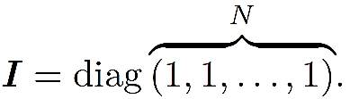


whitening transformation（白化变换）
In general, w ∼ N(0,Σ), where the off-diagonal components of Σ are not zero. The measurements can be converted so that w_{i} ∼ (0, σ²) by applying a whitening transformation D.
We assume Σ is positive definite.
where D is an N × N invertible matrix（可逆矩阵）.
The matrix D acts as a whitening transformation when applied to w, since
where
We apply D to y = Hθ + w
where
□
Notes:
whitening transformation D.
In some applications the noise components wi are not independent. In this case w ∼ N(0,Σ), where the off-diagonal components of Σ are not zero.
However, we may always convert the measurements so that wi ∼ N(0, σ2) by applying a whitening transformation D.

Slide 29
9.6.1 Line Fitting（线性拟合）
In curve fitting, the matrix H is completely specified. —— to estimate the vector θ assuming H is given but having no a priori knowledge regarding θ or σ.
H does not appear. We eliminate σ by marginalization.
The MAP estimate for the parameter vector θ:
直（曲）线拟合就是用解析表达式逼近离散数据，即离散数据的公式化.
Notes:
9.6.1 Line Fitting
In curve fitting the matrix H is completely specified. In this case, our objective
is to estimate the vector θ assuming H is given but having no a priori

Slide 30
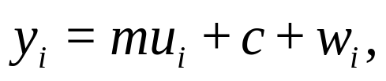
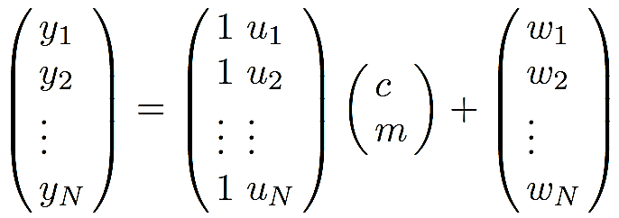
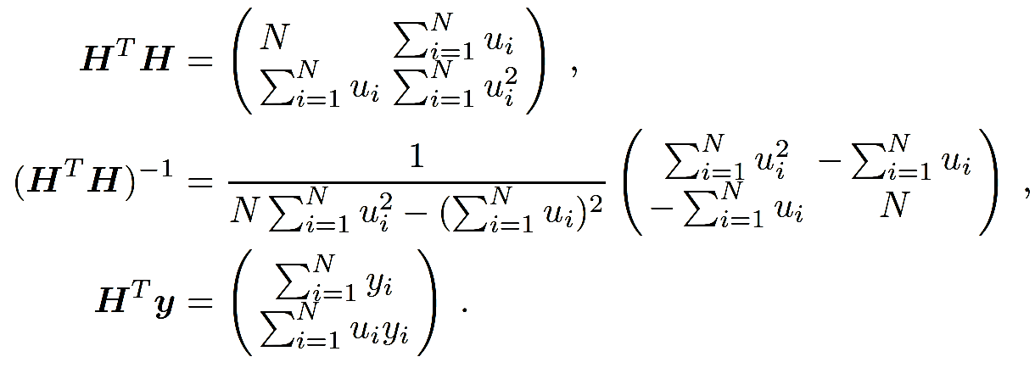
Example 9.11. Straight-Line Regression. （直线回归）
A set of points (u_{i}, y_{i}), i ∈{1, 2, . . .,N} obey the following straight-line equation:
w_{i} ∼ N(0, σ²)
直线回归是研究两个连续变量X和Y之间的数量依存关系，又称简单回归。
Notes:
Example 9.11. Straight-Line Regression.
We consider a set of points (ui, yi), i ∈ {1, 2, . . .,N} which we assume to obey the following straight-line equation:
yi = mui + c + wi ,
where wi ∼ N(0, σ2) are independent random noise. The corresponding matrix equation is

Slide 31
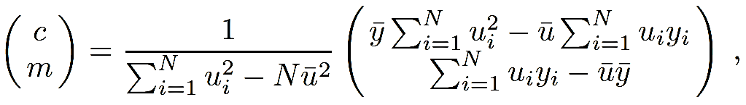
Substituting all these terms in (9.29)
MAP estimate of (c,m)^{T} .
This solution is identical to the solution obtained using the method of maximum likelihood or least squares
□
Notes:
Not unexpectedly [2] this solution is identical to the solution obtained using the method of maximum likelihood or least squares.

Slide 32
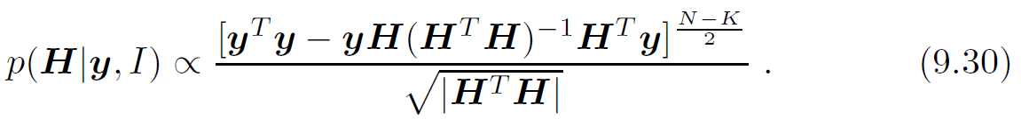
9.6.2 Change Point Detection（变点测试）
Central concept —— an observed time sequence is modelled by different models at different points in time.
The models are known, but the time instants at which the models change are not known.
In this case, our objective is to estimate H.
We eliminate θ and σ from (9.27) by marginalization.

Slide 33
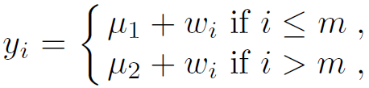
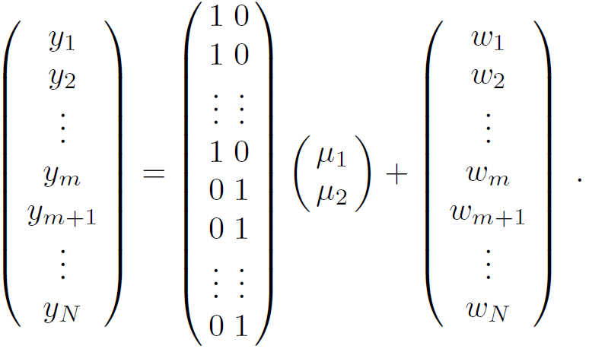

Example 9.12. Single Step in Piecewise Constant Time Series. 分段常时间序列的单个跳变
Given a set of scalar input measurements, y = (y₁, y₂, . . . , y_{N})^{T} , assuming there is a single (unknown) change point.
where m is an unknown integer (1 ≤ m ≤ N) and w_{i} ∼ N(0, σ²) are independent random noise.
Notes:
Example 9.12. Single Step in Piecewise Constant Time Series [84, 271]. We
consider a time series yi:

Slide 34



Substituting all these terms in (9.30)
The corresponding MAP estimate of m is
The associated μ₁ and μ₂ values are:
□
Notes:
Not unexpectedly [2] this solution is identical to the solution obtained using the method of maximum likelihood or least squares.

Slide 35


Example 9.13. Single Ramp in a Time Series 一个时间序列中的单个斜坡
Considering a time series y_{i} :
where w_{i} ∼ N(0, σ²) are independent random noise.
□
Notes:
Example 9.13. Single Ramp in a Time Series [84, 271]. We consider a time
series yi:

Slide 36


Example 9.14. Mixed Two and Three-Order AR Process.混合两阶三阶AR过程
Considering a time series y_{i} :
where w_{i} ∼ N(0, σ²) are independent random noise.
□

Slide 37


9.6.3 Probabilistic Subspace（概率子空间）
Probabilistic principal component analysis (PPCA，概率主成份分析)
a probabilistic version of the principal component analysis (PCA) algorithm.
Modeling the sensor measurements y_{i} using a linear Gaussian model,
where we assume
where
Notes:
Subspace techniques are a family of techniques which may be used to generate a low dimensional common representational format (see Sect. 4.5).
Recently probabilistic versions of several subspace techniques have been described.
In this section we concentrate on the probabilistic principal component analysis (PPCA) [300, 301] which is a probabilistic version of the principal component analysis (PCA) algorithm (see Ex. 4.11).

Slide 38

The a posteriori pdf p(θ|y, I)
where
Notes:
Not unexpectedly [2] this solution is identical to the solution obtained using the method of maximum likelihood or least squares.

Slide 39

Maximum-likelihood estimates of the unknown parameters
where
λ_{L+1}, …, λ_{M} —— the smallest eigenvalues of the sample covariance matrix Σ,
the L columns in the M×L orthogonal matrix U are the dominant L eigenvectors of Σ
Λ = diag(λ₁, . . . , λ_{L}) ,
R —— an arbitrary L×L orthogonal matrix .
Notes:
Not unexpectedly [2] this solution is identical to the solution obtained using the method of maximum likelihood or least squares.

Slide 40
Model arbitrary pdf’s using a mixture of PPCA’s instead of a mixture of Gaussians
by using PPCA’s to reduce the impact of the “curse of dimensionality”.
The number of free parameters:
In a mixture of full covariance M-dimensional Gaussian pdf’s —— M(M + 3)/2 parameters per pdf.
In a mixture of diagonal covariance M-dimensional Gaussian pdf’s —— 2M per pdf.
In a mixture of L component PPCA’s —— L(L +1)+1+L(L−1)/2 per PPCA.
Notes:
Example 9.15. PPCA vs. GMM [301].
A partially open circle in (x, y)-space is sampled after adding iid (independent and identically distributed) Gaussian noise.
In this case M = 2.
We model the data using a mixture of full covariance, and diagonal covariance, Gaussian pdf’s and a mixture of one
component (L = 1) PPCA’s. Fig. 9.3 shows the results obtained.

Slide 41


Example 9.15. PPCA vs. GMM .
Fig. 9.3. Shows the modeling of a noisy partially open circle in two-dimensions.
(a) the data points in (x, y) space.
(b) the three one-component PPCA’s we use to model the points.
(c) the three full-covariance Gaussian mixture we use to model the points.
(d) the three diagonal covariance Gaussian mixture we use to model the points.
□
Notes:
Fig. 9.3. Shows the modeling of a noisy partially open circle in two-dimensions.
(a) Shows the data points in (x, y) space.
(b) Shows the three one-component PPCA’s we use to model the points.
(c) Shows the three full-covariance Gaussian mixture we use to model the points.
(d) Shows the three diagonal covariance Gaussian mixture we use to model the points.

Slide 42
Example 9.16. Voice Conversion Using a Mixture of PPCA’s.
Using a mixture of PPCA’s instead of the more usual mixture of Gaussians.
Voice conversion is the art of transforming one speaker’s voice to sound as if it were uttered by another speaker. Eg.,the dubbing of a “original” film sound track.
By using voice conversion we obtain a sound track spoken in a foreign language by a speaker whose voice matches that of the original performer.
It is advantageous to use a mixture of PPCA’s instead of the more conventional mixture of Gaussians.
□
Notes:
The following example illustrates an unusual application which uses a mixture of PPCA’s instead of the more usual mixture of Gaussians.
Example 9.16. Voice Conversion Using a Mixture of PPCA’s [328].
Voice conversion is the art of transforming one speaker’s voice to sound as if it were uttered by another speaker.
One application of voice conversion deals with the dubbing of a “original” film sound track.
When a popular movie is exported to a foreign country, the sound track is often re-recorded by replacement speakers who speak a translated version of the original performer’s part.
By using voice conversion we obtain a sound track spoken in a foreign language by a speaker whose voice matches that of the original performer.
For this application the authors found it advantageous to use a mixture of PPCA’s instead of the more conventional mixture of Gaussians.

Slide 43



9.7 Generalized Millman Formula（广义Millman公式）
The generalized Millman’s formula deals with the optimal linear combination of an arbitrary number of correlated estimates. （任意个相关估计的最佳线性组合）
K local estimates, μ₁, μ₂, . . . ,μ_{K}, of an unknown L-dimensional random vector θ. Then the optimal linear estimate of θ is
where
and the W_{k} are L×L constant weighting matrices determined from the least square error criterion
Notes:
9.7 Generalized Millman Formula
The generalized Millman’s formula [277] deals with the optimal linear combination
of an arbitrary number of correlated estimates. Suppose we have K
local estimates, μ1,μ2, . . . ,μK, of an unknown L-dimensional random vector
θ. Then the optimal linear estimate of θ is

Slide 44

The solution to this problem is given by the following set of (K − 1) linear equations
subject to (9.41), where
Σ_{k,k} ≡ Σ_{k} is the L×L covariance matrix Σ_{k,k} = E(θ − μ_{k})(θ − μ_{k})^{T} and Σ_{k,l}, k ≠ l is the L×L cross-covariance matrix Σ_{k,l} = E(θ − μ_{k})(θ − μ_{l})^{T} .
Notes:
9.7 Generalized Millman Formula
The generalized Millman’s formula [277] deals with the optimal linear combination
of an arbitrary number of correlated estimates. Suppose we have K
local estimates, μ1,μ2, . . . ,μK, of an unknown L-dimensional random vector
θ. Then the optimal linear estimate of θ is

Slide 45

Example 9.17. Millman Formula.
Given two uncorrelated estimates μ₁ and μ₂, the generalized Millman formula reduces to
—— the optimum linear estimate
□
Example 9.18. Bar-Shalom-Campo Formula.
Given two correlated estimates μ₁ and μ₂, the generalized Millman formula reduces to the Bar-Shalom-Campo formula:
□
Notes:
Example 9.17. Millman Formula [98].
Given two uncorrelated estimates μ1 and μ2, the generalized Millman formula reduces to
Example 9.18. Bar-Shalom-Campo Formula [12].
Given two correlated estimates μ1 and μ2, the generalized Millman formula reduces to the Bar-Shalom-Campo formula:

Slide 46

Thank you for your attention!

